Slide 1


Introduction to NoSQL Databases
CS 537- Big Data Analytics Dr. Faisal Kamiran

Slide 2
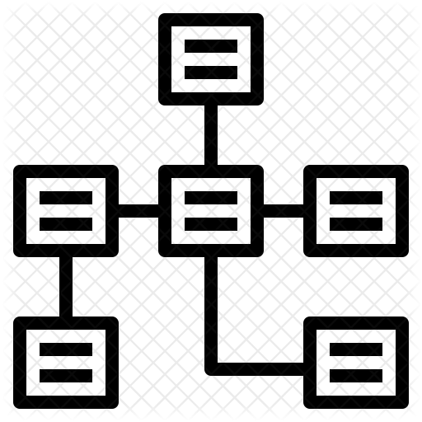
RELATIONAL DATABASES
Benefits of Relational databases:
Designed for all purposes
ACID
Strong consistency
Mathematical background
Standard Query language (SQL)
Lots of tools to use with i.e: Reporting services, entity frameworks

Slide 3

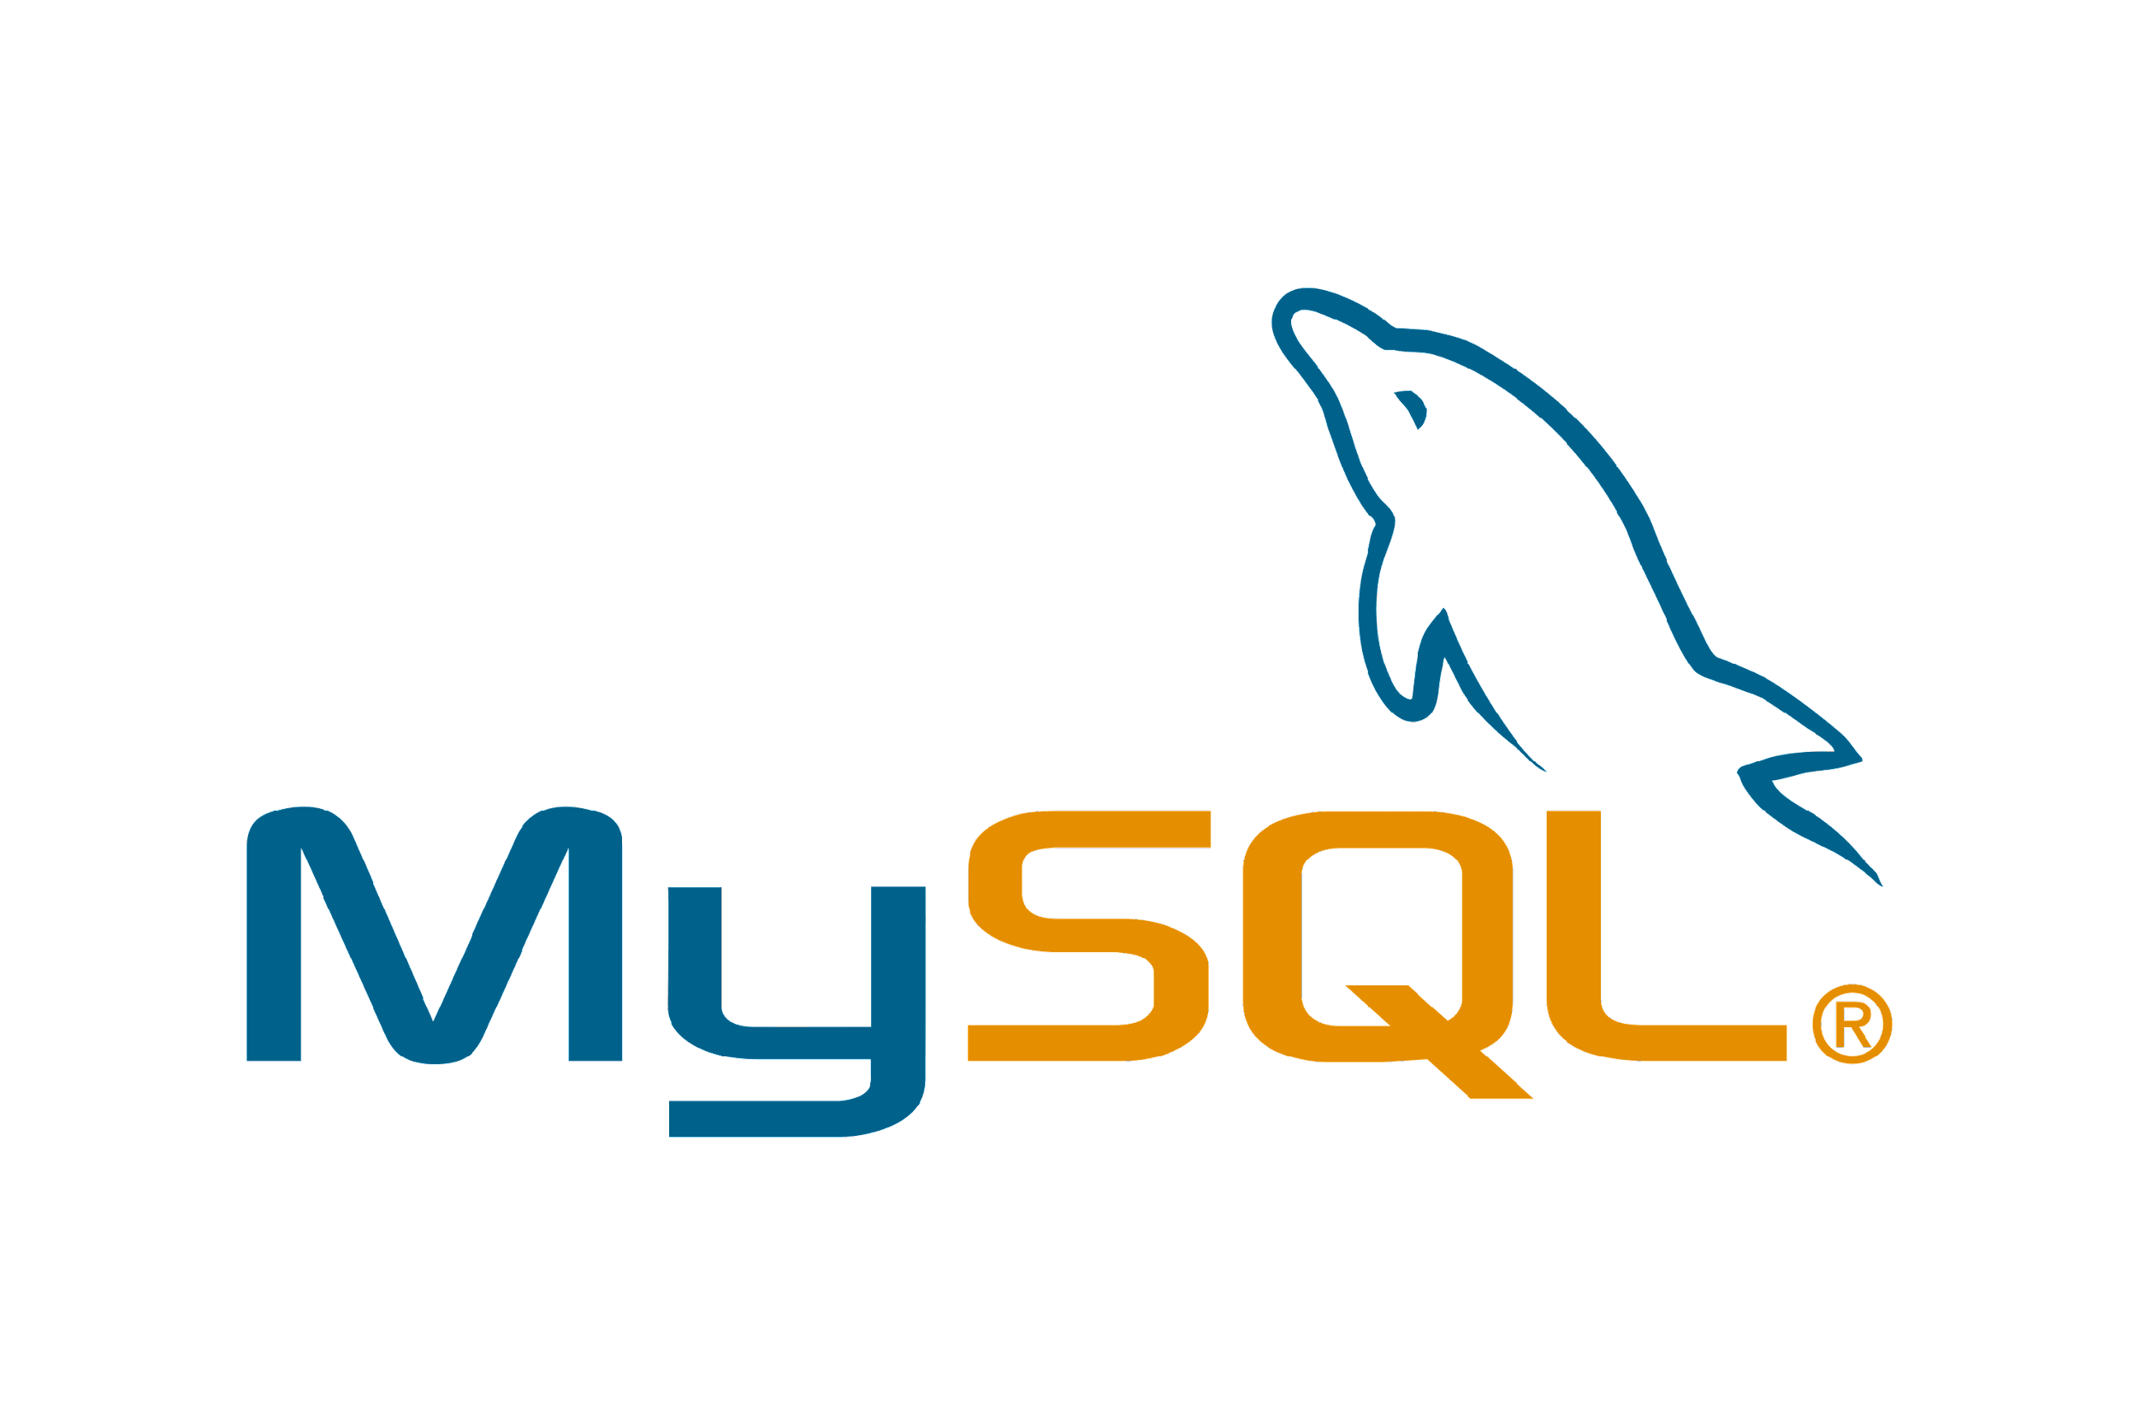

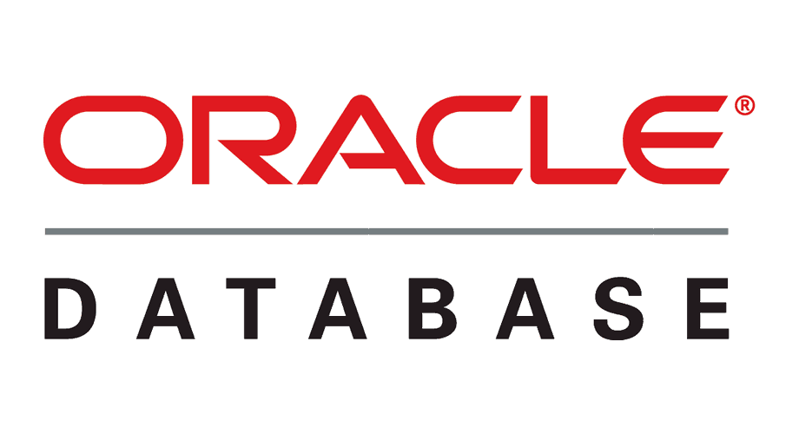

RELATIONAL DATABASES
In general, RDBMS systems have been considered as the one-size-fits-all data retrieval and persistence solution for decades

Slide 4
RELATIONAL DATABASES - CHALLENGES
Dramatic decrease in storage costs - Exponential rise in data applications
Variations in Data
Continuously evolving schema with change in requirements
Single point of failure
Notes:
Variations in data due to rise in structured as well as mainly due to unstructured data over the years
Changes in requirements in projects due to
As work is done on a problem, users ask what is possible and ask for more features
Client changes mind

Slide 5
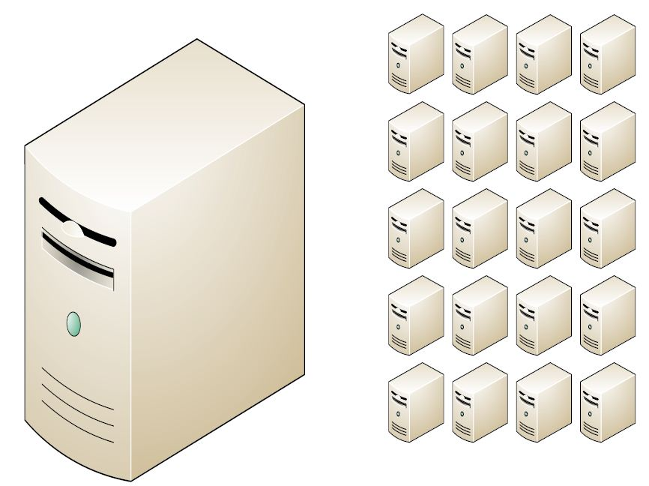
RELATIONAL DATABASES - CHALLENGES
Relational databases were not built for distributed applications.
Because...
Joins are expensive
Hard to scale horizontally
Expensive (product cost, hardware, maintenance)

Slide 6
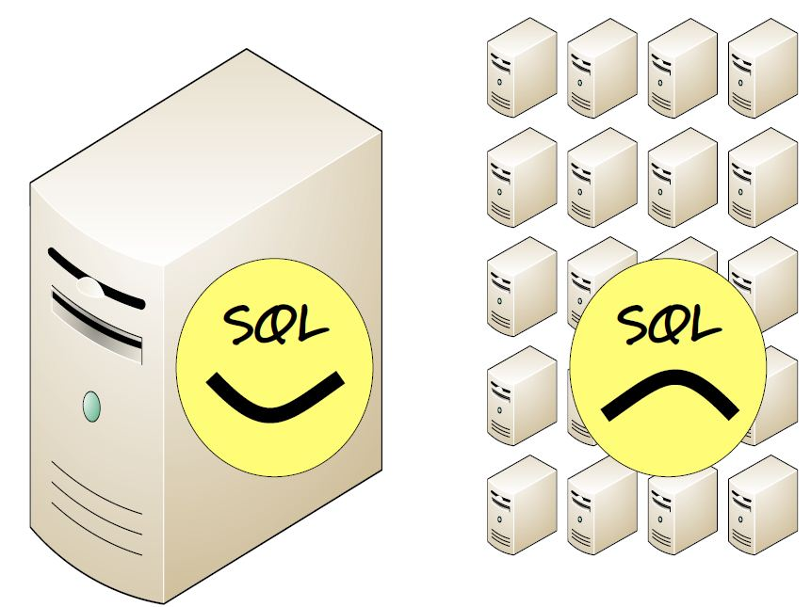
RELATIONAL DATABASES - CHALLENGES
Relational databases were not built for distributed applications.
Because...
Joins are expensive
Hard to scale horizontally
Expensive (product cost, hardware, maintenance)

Slide 7
MODERN DATA REQUIREMENTS
Explosion of social media sites (Facebook, Twitter) with large data needs
Rise of cloud-based solutions such as Amazon S3 (simple storage solution)
Constantly changing requirements
High-Velocity Data requiring fast query processing
Increasingly sparse and semi-structured data
Notes:
Point 3: Just as moving to dynamically-typed languages (Python), a shift to dynamically-typed data with frequent schema changes. Now, in many applications, data capture and management needs are constantly evolving, so a rigid schema is not suitable

Slide 8
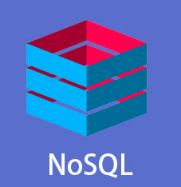
NOSQL DATABASES
NoSQL stands for:
No Relational
No RDBMS
Not Only SQL
Allows SQL-like query languages to be used.
NoSQL is an umbrella term for all databases and data stores that do not follow the RDBMS principles

Slide 9
NOSQL DATABASES
“Next Generation Database Management Systems mostly addressing some of the points: being non-relational, distributed, open-source and horizontally scalable.”
-- Nosql-database.org
The primary objective of a NoSQL Database is to have:
Simplicity of design
Horizontal scaling
Finer control over availability

Slide 10
Where does NoSQL come from?
But NoSQL represents a new incarnation
Due to massively scalable Internet applications
Based on distributed and parallel computing
Development
Starts with Google
First research paper published in 2003
Continues also thanks to Lucene's developers/Apache (Hadoop) and Amazon (Dynamo)
Then a lot of products and interests came from Facebook, Netfix, Yahoo, eBay, Hulu, IBM, and many more

Slide 11
Dynamo and BigTable
Three major papers were the seeds of the NoSQL movement
BigTable (Google)
Dynamo (Amazon)
Distributed key-value data store
Eventual consistency
CAP Theorem
Notes:
-> BigTable: http://labs.google.com/papers/bigtable.html
-> Dynamo: http://www.allthingsdistributed.com/2007/10/amazons_dynamo.html and http://www.allthingsdistributed.com/files/amazon-dynamo-sosp2007.pdf
-> Amazon and consistency
* http://www.allthingsdistributed.com/2010/02
* http://www.allthingsdistributed.com/2008/12

Slide 12
NoSQL and Big Data
NoSQL comes from Internet, thus it is often related to the “big data” concept
How much big are “big data”?
Over few terabytes Enough to start spanning multiple storage units
Challenges
Efficiently storing and accessing large amounts of data is difficult, even more considering fault tolerance and backups
Manipulating large data sets involves running immensely parallel processes
Managing continuously evolving schema and metadata for semi-structured and un-structured data is difficult

Slide 13
NoSQL Distinguishing Characteristics
Large data volumes
Google’s “big data”
Scalable replication and distribution
Potentially thousands of machines
Potentially distributed around the world
Queries need to return answers quickly
Mostly query, few updates
Schema-less
ACID transaction properties are not needed – BASE
CAP Theorem
Open source development

Slide 14
CHARACTERISTICS OF NOSQL DATABASES
THEY AVOID | THEY ALLOW
Overhead of ACID transactions | Easy and frequent changes to DB
Complexity of SQL query | Fast development
Burden of up-front schema design | Large data volume
DBA presence | Schema less
Transactions (It should be handled at application layer) | Distributed

Slide 15
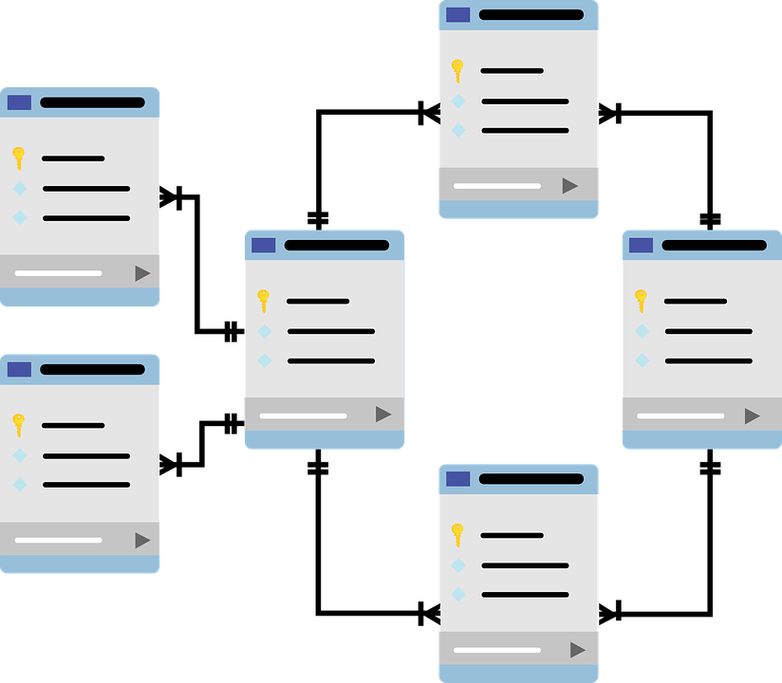
SCHEMA BASED DATA MODELLING
In RDBMS, a schema describes every functional element, including tables and rows
Exerts a high degree of control and prevents capture of low-quality data

Slide 16
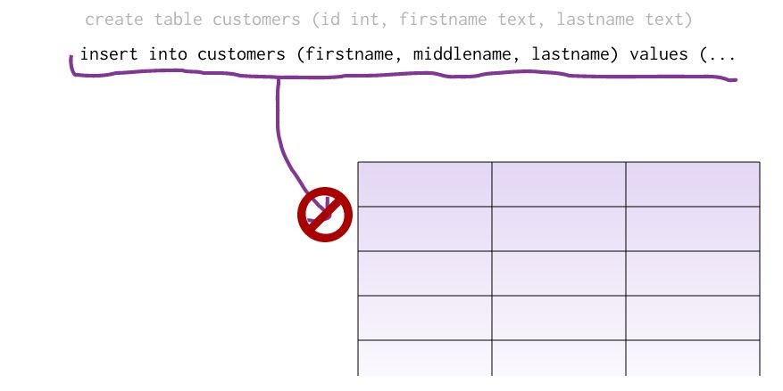
SCHEMA BASED DATA MODELLING
Problems
Cannot add a record which does not fit the schema
Need to add NULLs to unused items in a row
Need to consider the data types - cannot add a string to an integer field
Cannot add multiple items in a field
Notes:
Point 4
Cannot add multiple items in a field (Instead one is forced to create another table: primary-key, foreign key, joins, normalization, ... !!!)

Slide 17
SCHEMALESS DATA MODEL
In NoSQL Databases:
There is no schema to consider – No need to conform to a rigid schema
There is no unused cell
There are no datatype enforcements on columns
Most of the considerations are done in the application layer
Data can be rapidly transformed as requirements change
Facilitates the storage of unstructured data as well as structured data
Notes:
https://www.mongodb.com/unstructured-data/schemaless#:~:text=As%20a%20NoSQL%20database%2C%20MongoDB,schema%20like%20a%20relational%20database.&text=The%20applications%20you%20use%20to,are%20read%20from%20the%20database.
https://blog.couchbase.com/the-value-of-schema-less-databases/

Slide 18
SCHEMALESS DATA MODEL
Information stored in JSON-style documents which can have varying sets of fields with different data types for each field
{
"name":"Joe",
"age":30,
"interests":"football"
}
{
"name":"Kate",
"age":25
}

Slide 19
SCHEMALESS DATA MODEL - ADVANTAGES
No pre-defined database schemas
No data truncation
Suitable for real-time analytics
On demand scalability to meet extreme Volumes, Velocity and Variety of data
Notes:
No pre-defined database schemas
Database can accept any data type
Database can be adapted as the requirements change
No data truncation
No changes are made to the original data while adding it to the database
Nothing is stripped to match the current schema
Suitable for real-time analytics
Unstructured real-time data can be readily added
On demand scalability to meet extreme Volumes, Velocity and Variety of data

Slide 20
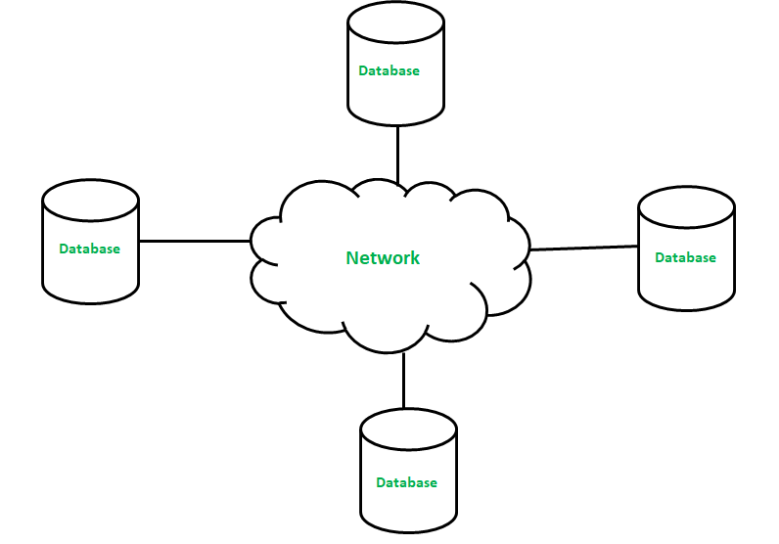
DISTRIBUTED ARCHITECTURE
Multiple NoSQL databases can be created in a distributed fashion
Data is physically stored across different sites
Reaches Eventual consistency
Offers auto-scaling and fail-over capabilities
Notes:
NoSQL databases allow horizontal scaling, which can be deployed over a distributed architecture. Albeit, ACID concept are sacrificed but we gain the added advantages of scalability, high availability and low latency
Reaches Eventual consistency – All the distributed nodes are updated with each other either through synchronous or asynchronous means
Synchronous Replication - All copies of a modified relation (or fragment) must be updated before the modifying transaction commits
Data distribution is made totally “transparent” (not visible!) to users. Slow
Asynchronous: Copies of a modified relation are only periodically updated; different copies may get out of sync in the meantime
More efficient – many current products follow this approach

Slide 21
BASE (NOT ACID)
Recall ACID for RDBMS desired properties of transactions
Atomicity, Consistency, Isolation, and Durability
NoSQL systems provide BASE and do not provide ACID
Basically Available
Soft state
Eventually consistent
Notes:
Basically Available: Guarantees the availability of the data. There will be a response to any request (can be failure too).
Soft state: The state of the system could change over time.
Eventual consistency: The system will eventually become consistent once it stops receiving input.

Slide 22
ACID VS. BASE
The idea is that by giving up ACID constraints, one can achieve much higher performance and scalability
The systems differ in how much they give up
e.g. most of the systems call themselves “eventually consistent”, meaning that updates are eventually propagated to all nodes
but many of them provide mechanisms for some degree of consistency, such as multi-version concurrency control (MVCC)

Slide 23
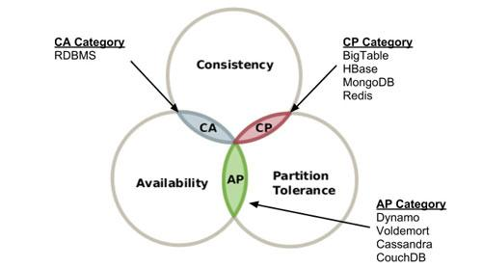
CAP THEOREM
Often Eric Brewer’s CAP theorem cited for NoSQL
A system can have only two out of three of the following properties:
Consistency – Data is same across all sites even after updates and deletions
Availability – Data is always immediately available
Partition-Tolerance – System continues to work even in the presence of a partial network failure

Slide 24
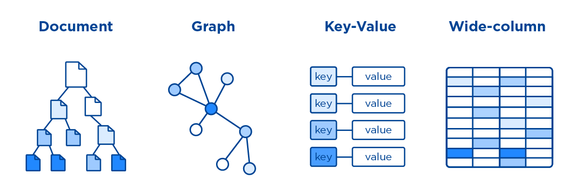
TYPES OF NOSQL DATABASES
Notes:
https://www.freecodecamp.org/news/nosql-databases-5f6639ed9574/#:~:text=%E2%80%8CNoSQL%20relies%20upon%20a%20softer,Soft%20state%2C%20Eventual%20consistency).&text=Eventual%20consistency%3A%20The%20system%20will,in%20return%20they%20improve%20scalability.

Slide 25
NoSQL Database Types
Sorted ordered Column Store
Optimized for queries over large datasets, and store columns of data together, instead of rows
Key-Value Store :
are the simplest NoSQL databases. Every single item in the database is stored as an attribute name (or 'key'), together with its value.
Document databases:
pair each key with a complex data structure known as a document.
Graph Databases :
are used to store information about networks of data, such as social connections.

Slide 26
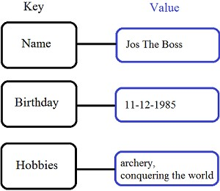
Key/Value stores
Store data in a schema-less way
Store data as maps
HashMaps or associative arrays
Provide a very efficient average running time algorithm for accessing data
Notable for:
Couchbase (Zynga, Vimeo, NAVTEQ, ...)
Redis (Craiglist, Instagram, StackOverfow, flickr, ...)
Amazon Dynamo (Amazon, Elsevier, IMDb, ...)
Apache Cassandra (Facebook, Digg, Reddit, Twitter,...)
Voldemort (LinkedIn, eBay, …)
Riak (Github, Comcast, Mochi, ...)

Slide 27
Document Databases (Document Store)
Documents
Loosely structured sets of key/value pairs in documents, e.g., XML, JSON, BSON
Encapsulate and encode data in some standard formats or encodings
Are addressed in the database via a unique key
Documents are treated as a whole, avoiding splitting a document into its constituent name/value pairs
Allow documents retrieving by keys or contents
Notable for:
MongoDB (used in FourSquare, Github, and more)
CouchDB (used in Apple, BBC, Canonical, Cern, and more)

Slide 28
Document Databases (Document Store)
The central concept is the notion of a "document“ which corresponds to a row in RDBMS.
A document comes in some standard formats like JSON.
Documents are addressed in the database via a unique key that represents that document.
The database offers an API or query language that retrieves documents based on their contents.
Documents are schema free, i.e., different documents can have structures and schema that differ from one another. (An RDBMS requires that each row contain the same columns.)

Slide 29
Document Databases, JSON
{
_id: ObjectId("51156a1e056d6f966f268f81"),
type: "Article",
author: "Derick Rethans",
title: "Introduction to Document Databases with MongoDB",
date: ISODate("2013-04-24T16:26:31.911Z"),
body: "This arti…"
},
{
_id: ObjectId("51156a1e056d6f966f268f82"),
type: "Book",
author: "Derick Rethans",
title: "php|architect's Guide to Date and Time Programming with PHP",
isbn: "978-0-9738621-5-7"
}

Slide 30
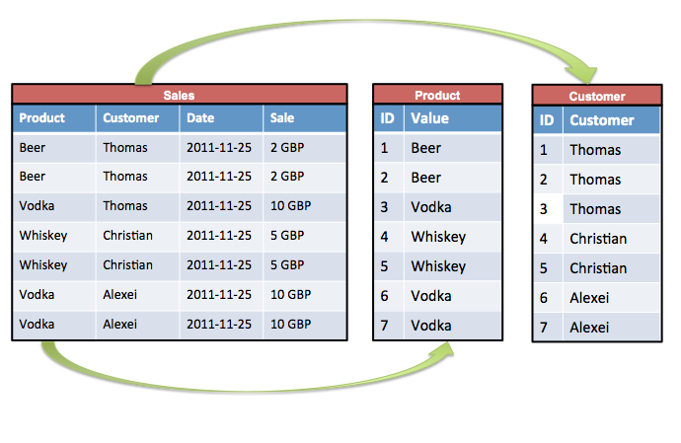
Sorted Ordered Column-Oriented Stores
Data are stored in a column-oriented way
Data efficiently stored
Avoids consuming space for storing nulls
Columns are grouped in column-families
Data isn’t stored as a single table but is stored by column families
Unit of data is a set of key/value pairs
Identified by “row-key”
Ordered and sorted based on row-key
Notable for:
Google's Bigtable (used in all Google's services)
HBase (Facebook, StumbleUpon, Hulu, Yahoo!, ...)

Slide 31
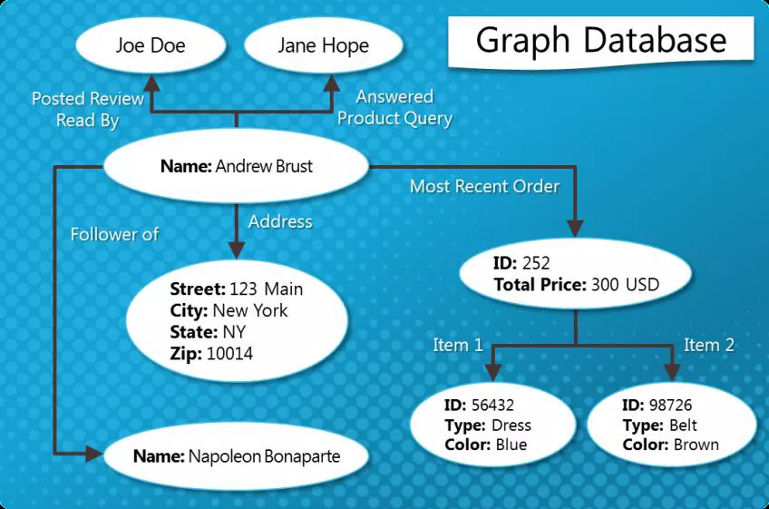
Graph Databases
Graph-oriented
Everything is stored as an edge, a node or an attribute.
Each node and edge can have any number of attributes.
Both the nodes and edges can be labelled.
Labels can be used to narrow searches.

Slide 32
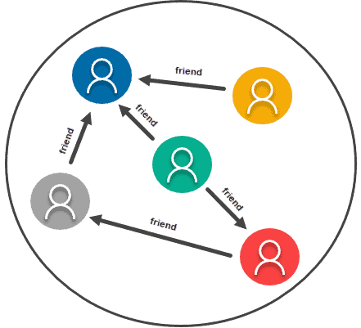
GRAPH BASED
Used to store fine-grained networks of inter-connected data
Stores entities as well the relations amongst the entities
Entity is stored as a node with the relationship as edges
Traversing persisted relationships are faster

Slide 33
WHEN TO USE A NOSQL DATABASE?
Large amounts of data
Terabytes and Petabytes of data
Need horizontal scalability
Need high throughput – fast reads
Need a flexible schema
No fixed number of columns
Need high availability
Need to be able to store different data type formats
Users are distributed – low latency
Need redundancy in case of failures

Slide 34
WHEN NOT TO USE A NOSQL DATABASE?
Need ACID Transactions
Need ability to do JOINS
Ability to do aggregations and analytics
Have changing business requirements
Queries are not available and need to have flexibility
Have a small dataset

Slide 35
End of Lecture

